Slide 1

Drew Beaudry
Arduino Piano
beaudryal18@uww.edu

Slide 2
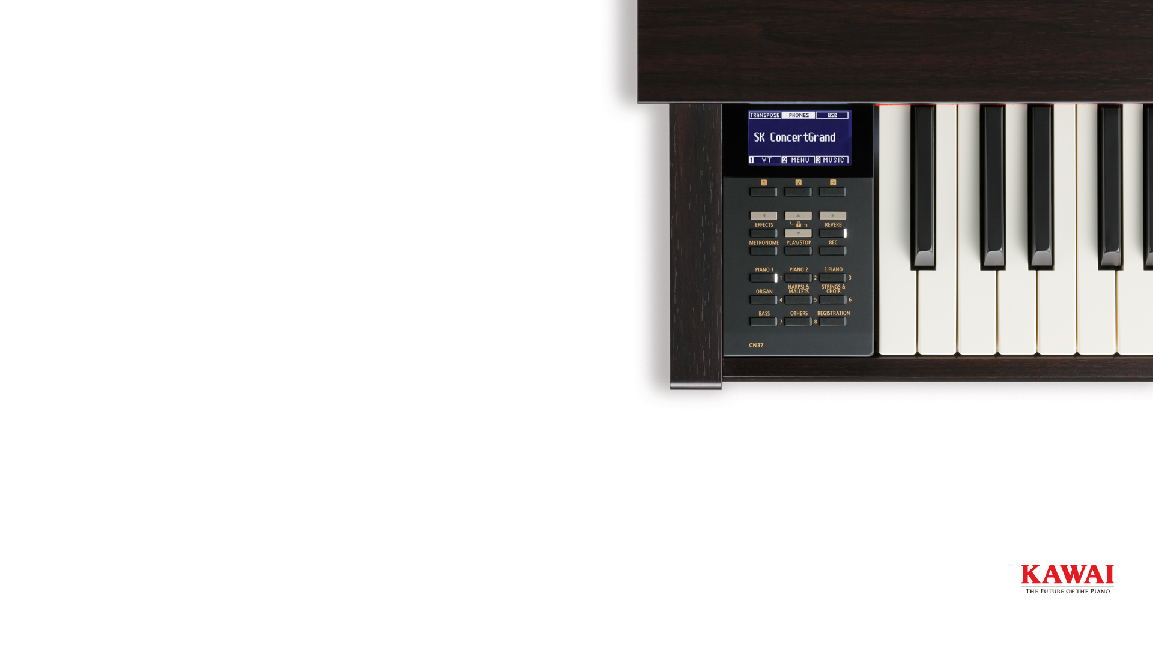
About the Project:
A project to teach children about music in a simple way.
An external interface to pick songs
5 buttons allow user to play notes
Sound will be emitted on each press
Buttons will light up in the order to be played
System will wait for user to play one note before lighting up the next

Slide 3

Why?
I love music and believe in its importance.
Music Experience:
My first instrument was a piano
I moved onto Trumpet and then Guitar
I’ve played guitar in two bands
I’ve created electronic music in Ableton Live
I’m a professional DJ with Midwest Sound

Slide 4

Background
What is it?
This is a 5 button light up keyboard that allows for Free-Play with the notes C4-G4
There are also two programmed songs from the Legend of Zelda: Sarias’ Song and the Song of Storms
These songs utilize more than 5 notes, as well as notes outside of the C4-G4 range
We assign notes to colored buttons similar to Guitar Hero
How do I pick Songs?
Connect to the device via Bluetooth
Establish a connection with any Bluetooth Terminal
Send the message ‘help’ to the device for a list of songs

Slide 5
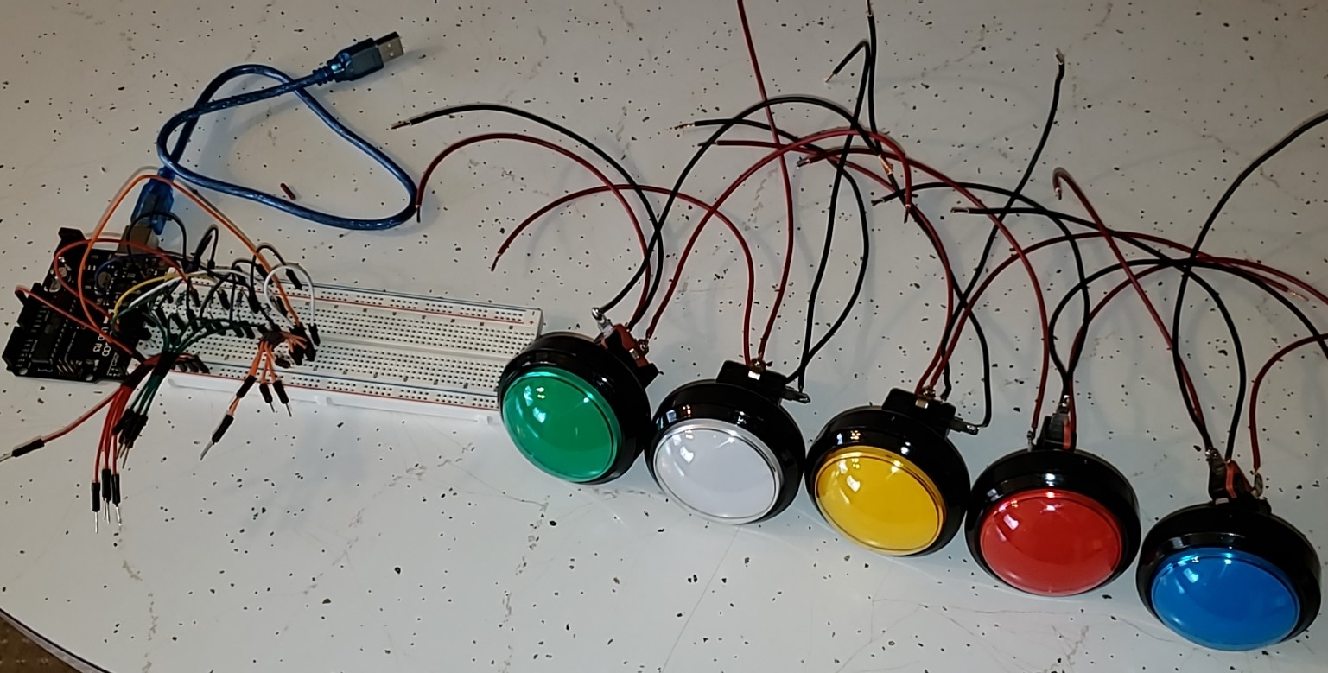
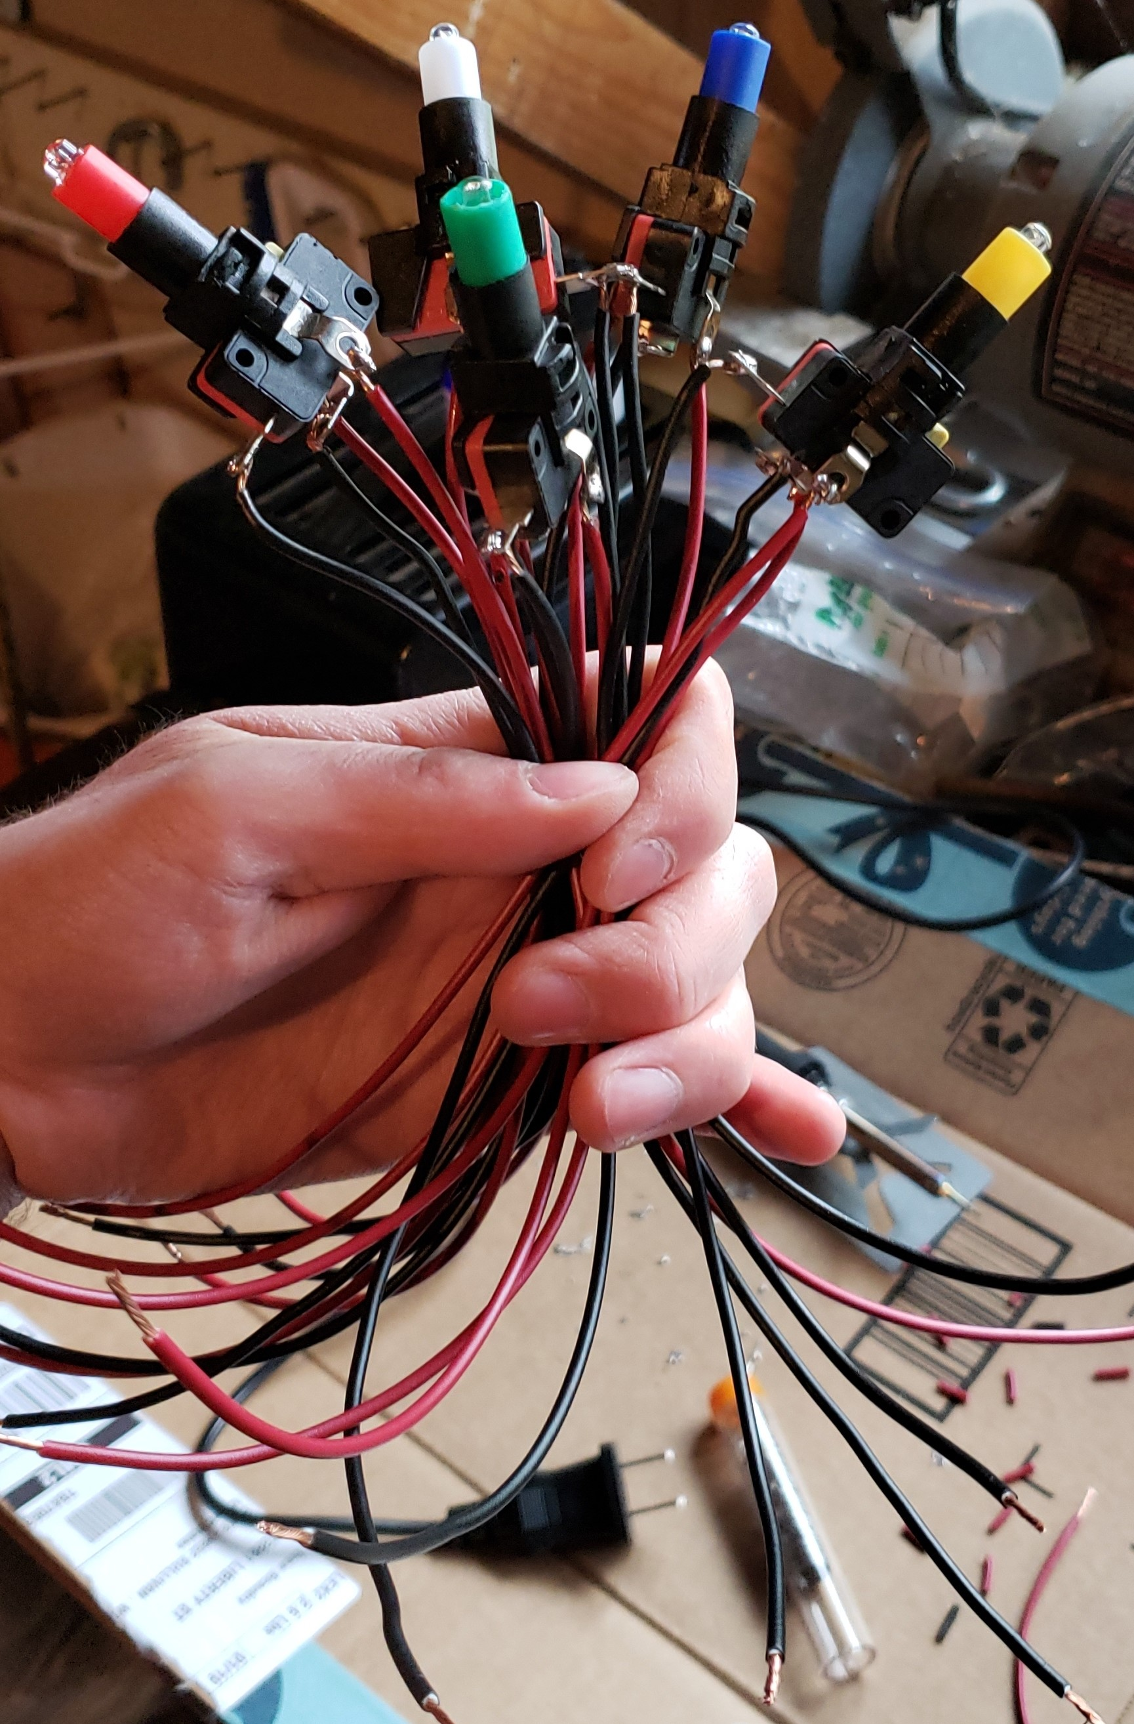
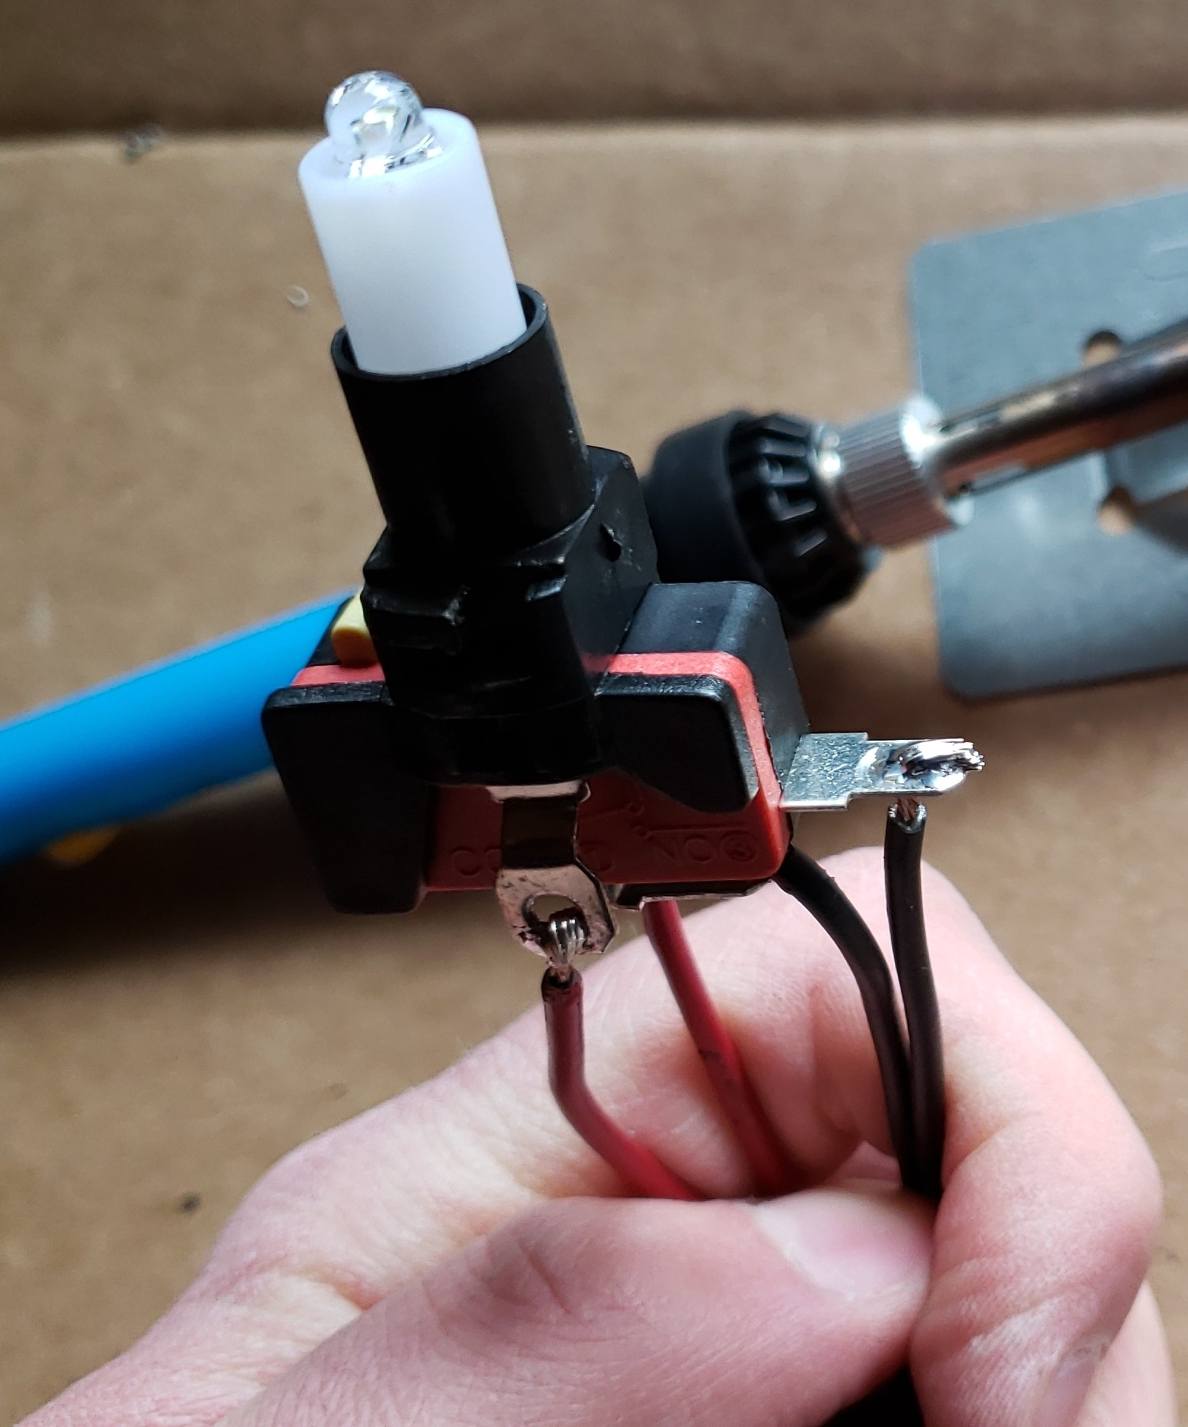
How?
Five 12v LED Buttons
Each button has 4 terminals
+/- for LED inside button
2 terminals for a circuit to complete upon button press
Cut and stripped 18 gauge wire and soldered to the terminals
Attached 18 gauge wire to jumper cables via 18-22 gauge butt connectors

Slide 6
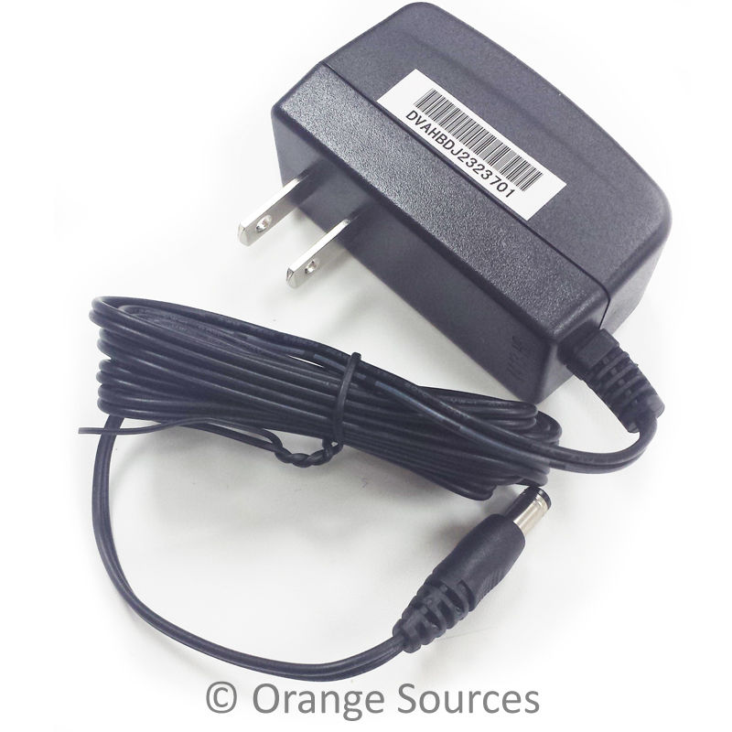
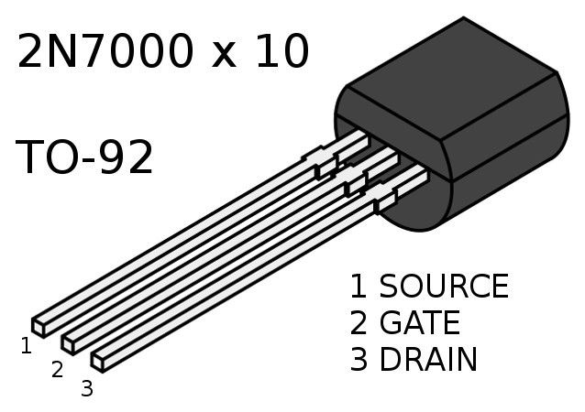
How?
Powering the 12v buttons?
12v 1 Amp Power supply
Wall adapter to barrel jack – plug into Arduino
Use “Vin” port on Arduino to access 12v power
2N7000 N-Channel Metal-oxide-semiconductor field-effect transistor (NPN MOSFET)
Supports up to 60v currents
Gate threshold of 0.8 volts minimum
Requires pull-down resistor to ground on gate
When we want to give the button a 12v current, we send a signal to the gate to trigger the MOSFET as a switch
Signal is sent via digitalWrite() from pins 2-7

Slide 7
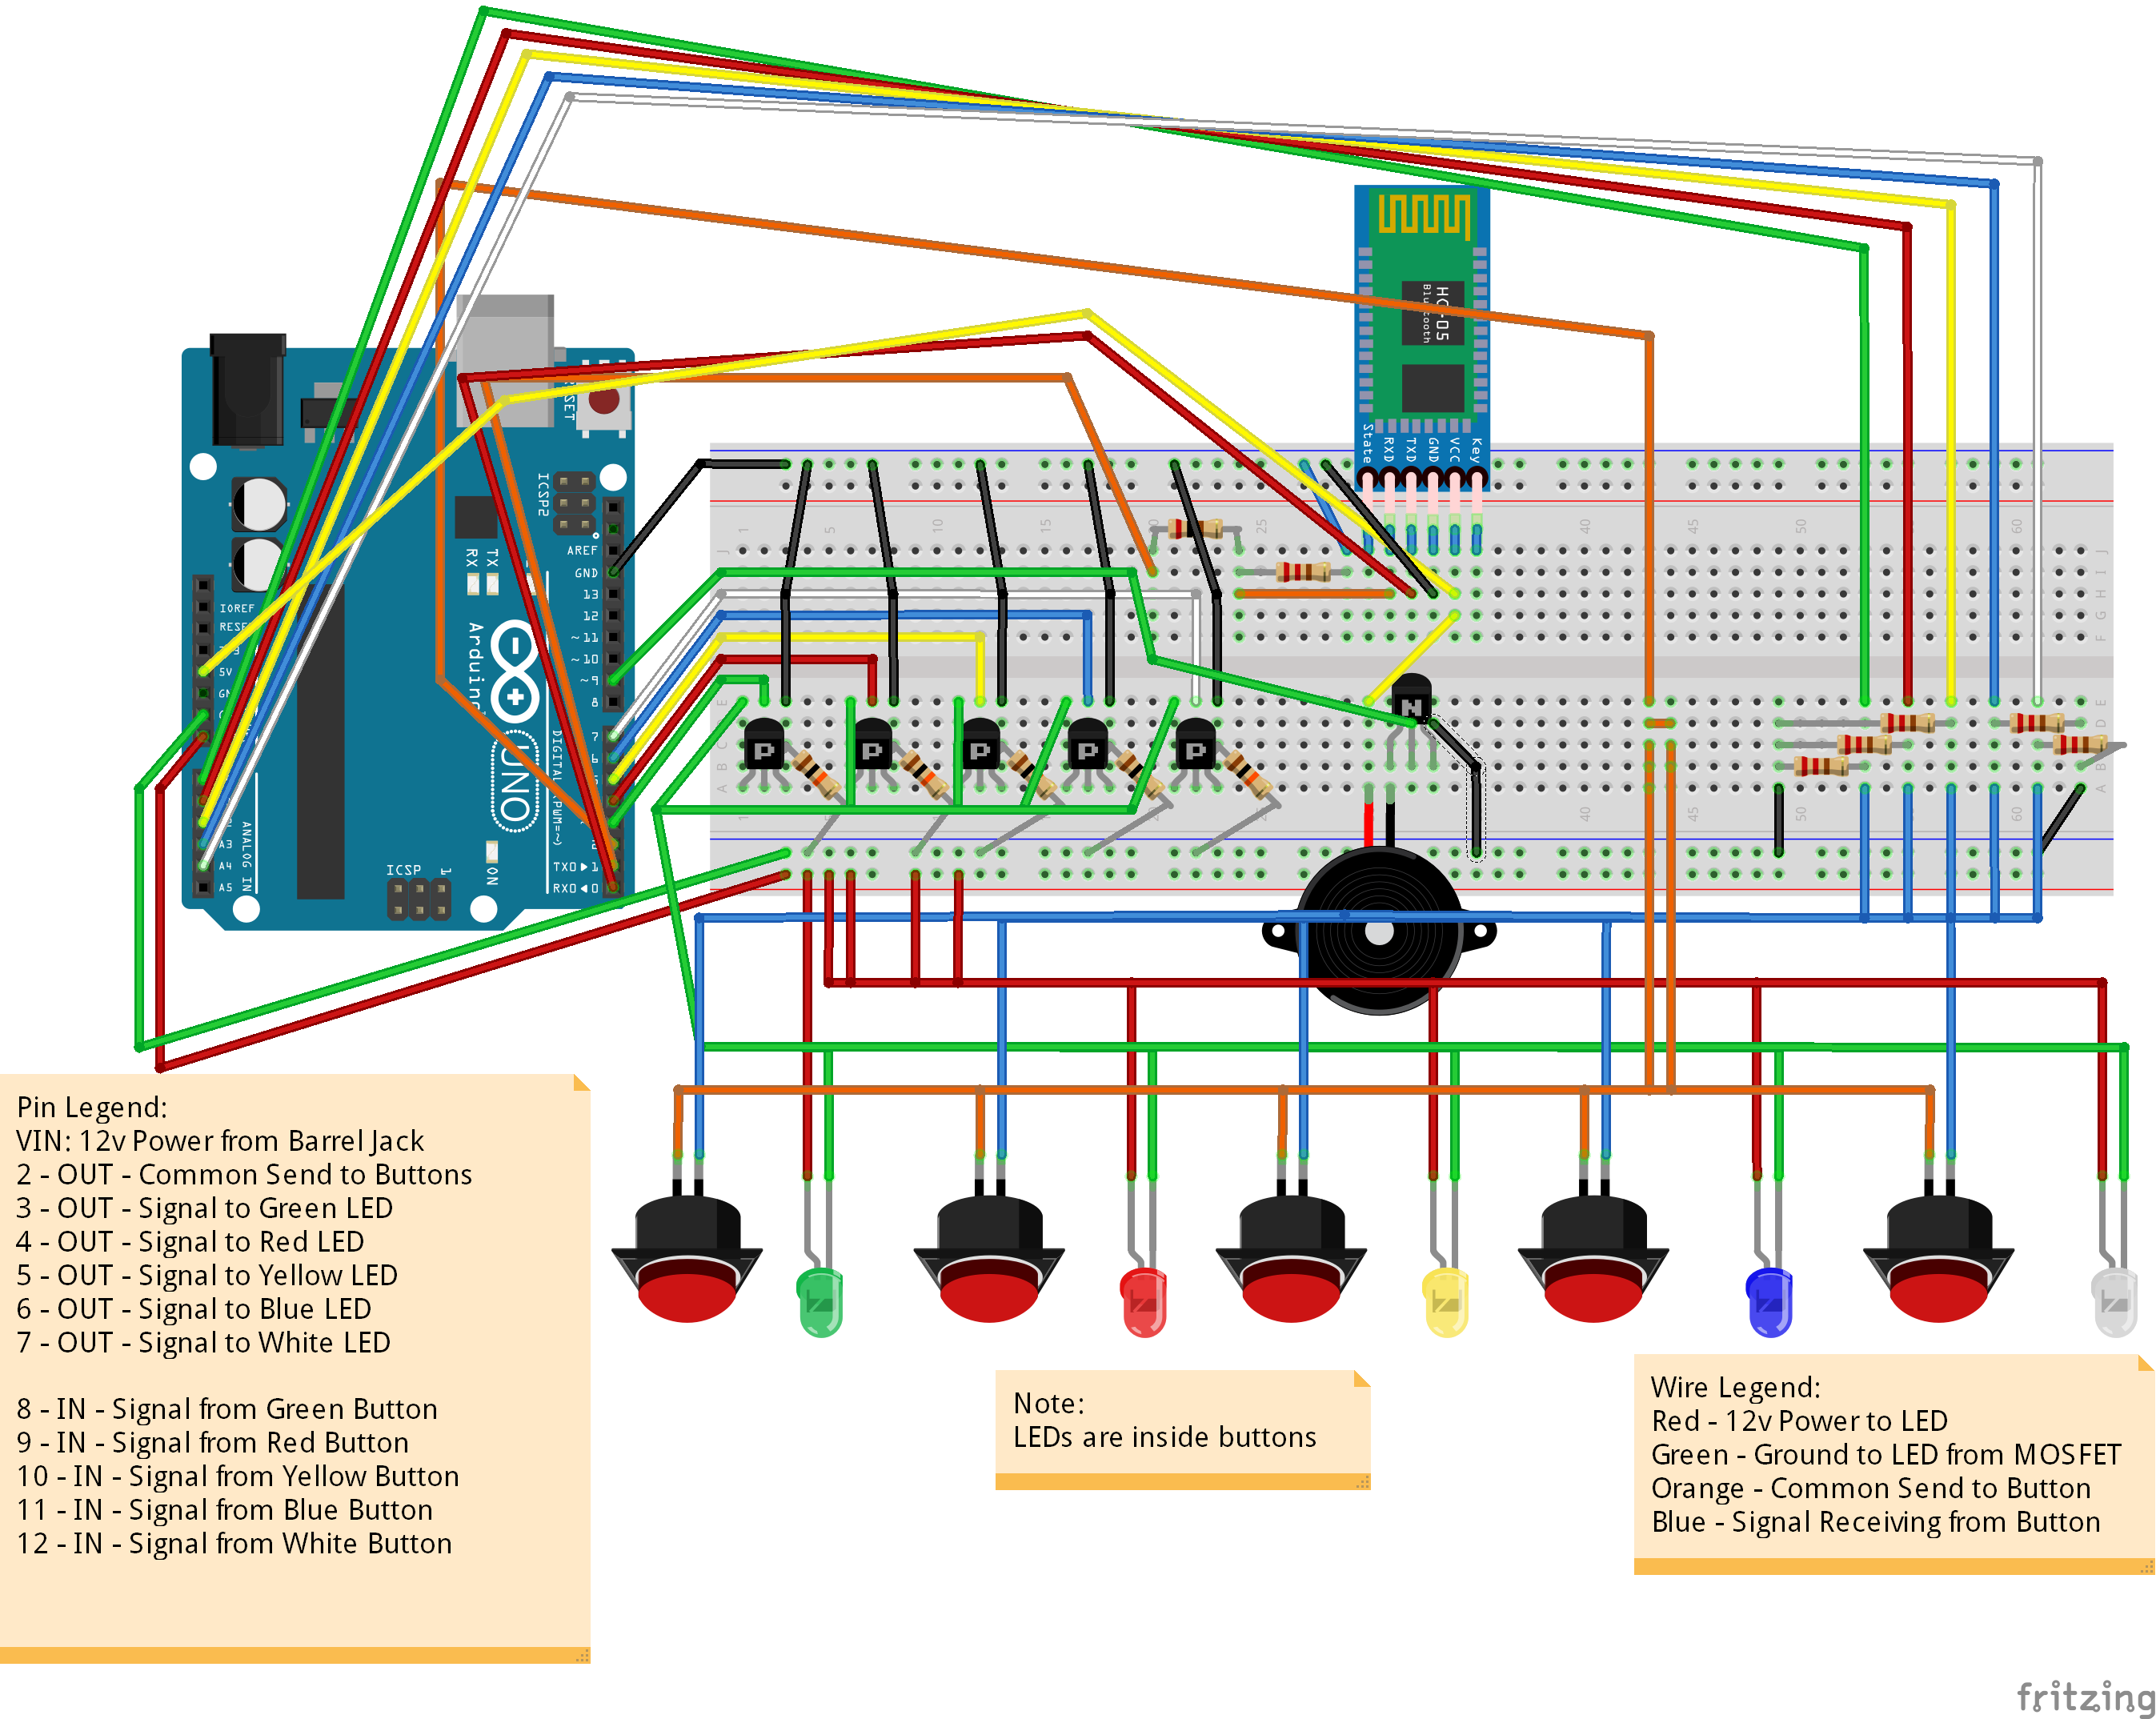

Slide 8
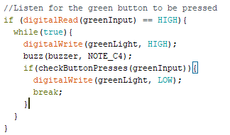
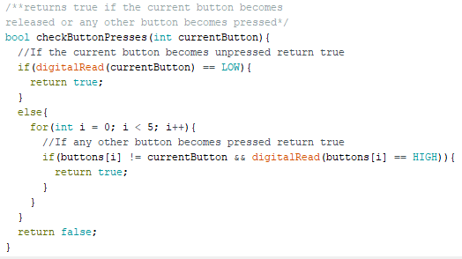
How?
How do we know what button is being pressed?
In setup() we digitalWrite a HIGH signal to all buttons
When a button is pressed it completes the circuit and a HIGH signal is sent back to the breadboard
5 wires from Arduino pins A0-A4 are waiting for signals on the breadboard
We digitalRead() on these pins constantly
Pull down resistors exist between pins and input to keep readings accurate

Slide 10
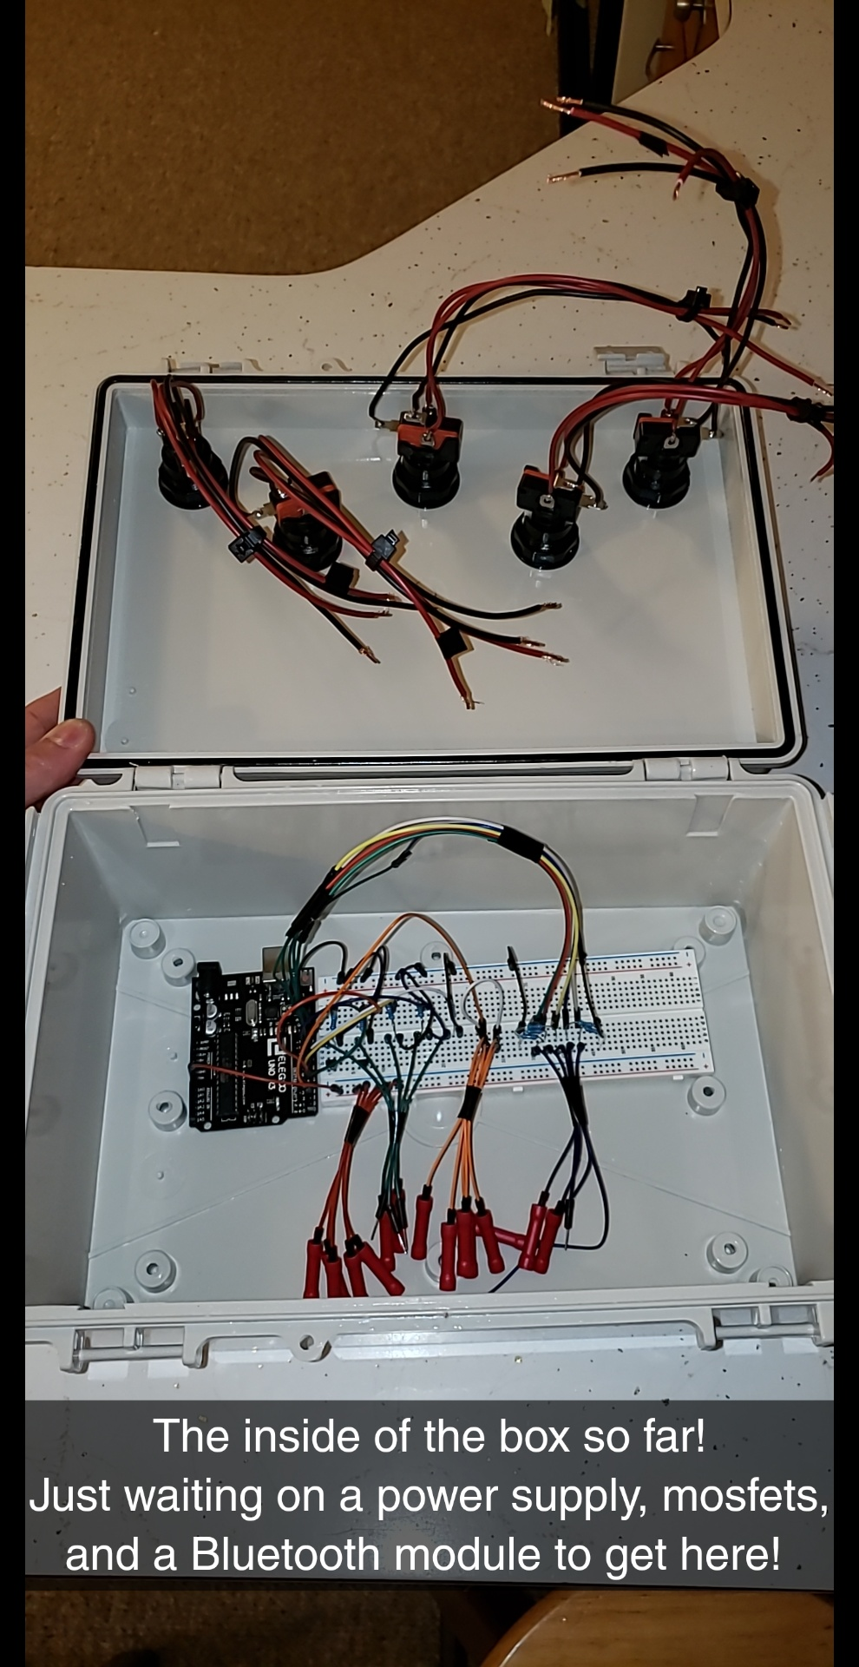
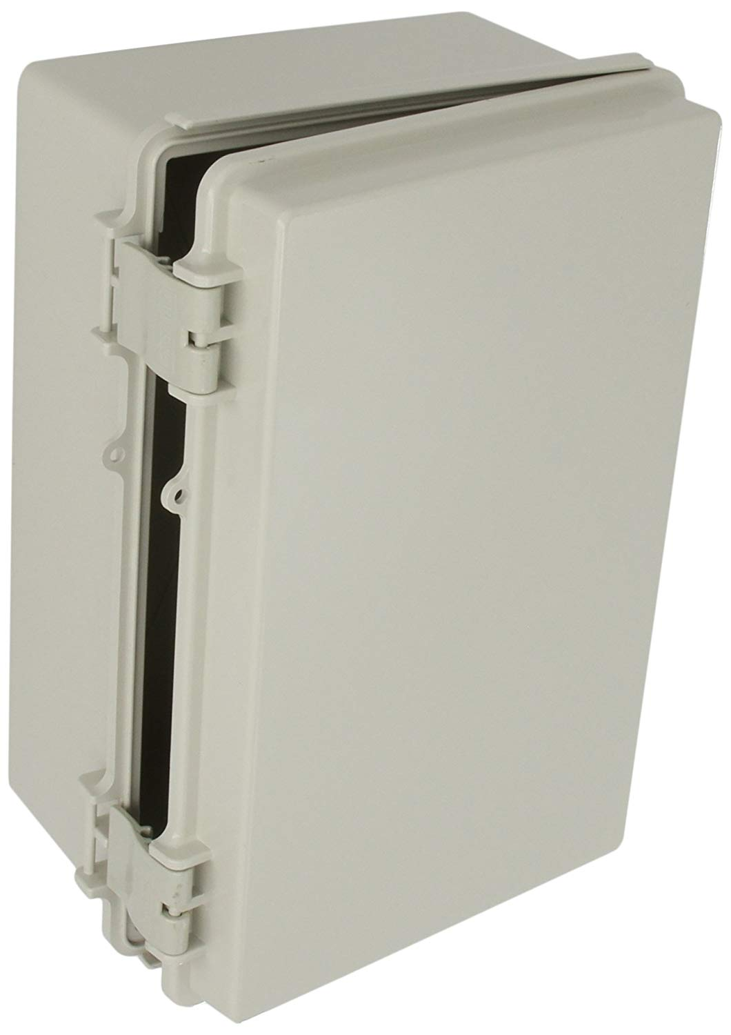
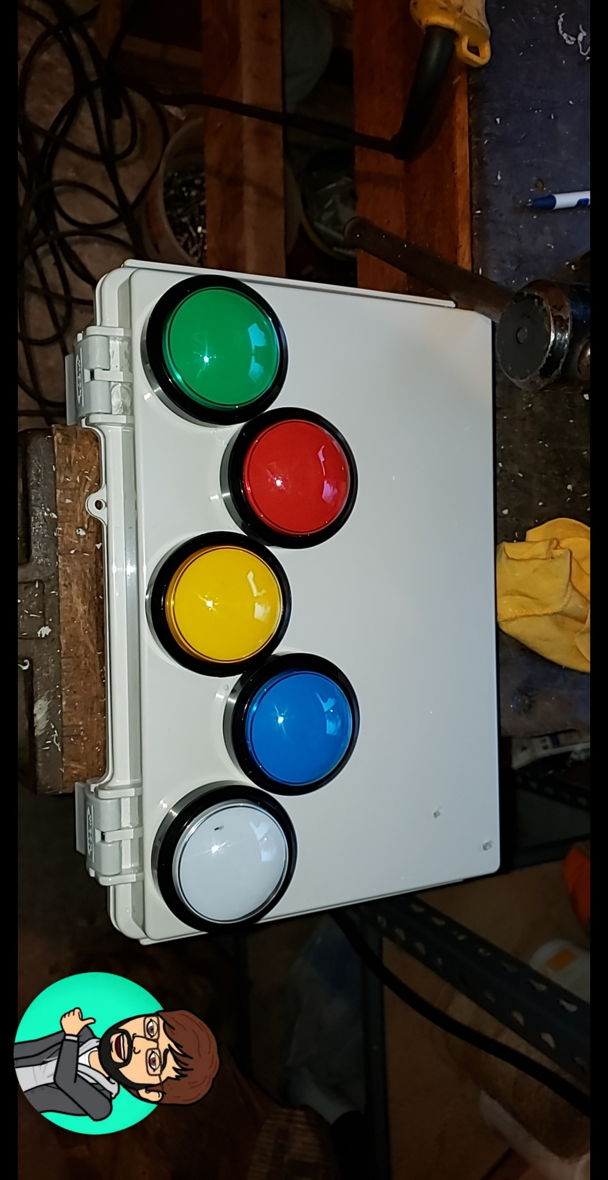
How?
Power tools! (and a Swiss Army Multi-tool)
Had to drill 5 large holes for mounting the buttons
Left space for an Android device on top
Hand-Drilled a small hole for the power supply wire
Used 3M Double sided tape for mounting devices

Slide 11
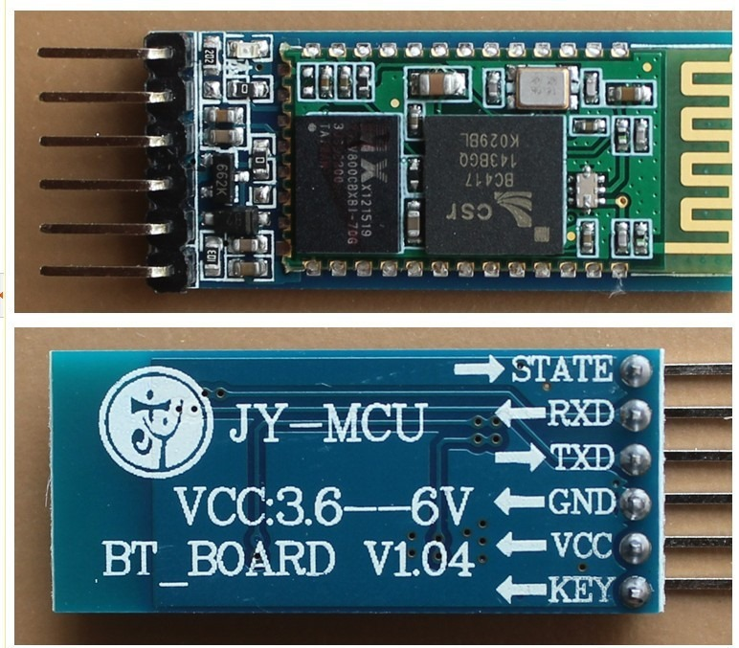
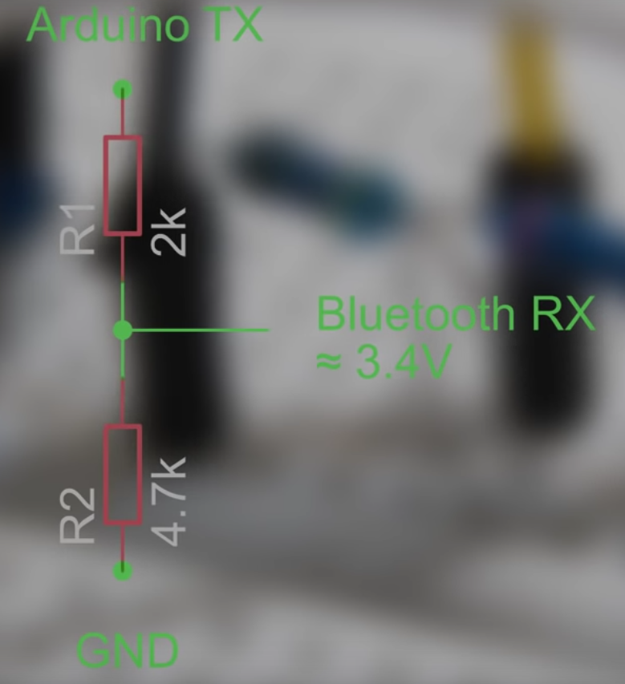
How?
Bluetooth?
HC-05 Bluetooth module
Connects to Arduino via pins 0 and 1
TX and RX pins
Problem: Arduino sends data to Bluetooth module from TX pin 1 at 5v, and Bluetooth module is rated for 3.5v signals
Voltage divider using 2k & 5K1 resistors
Turns 5v into 3.59v
Phone and Arduino communicate each with each other via Strings in Serial Monitor
Serial.available() tells us when we have a message waiting
Serial.readString() reads the message
String.indexOf() can tell us what the message contains

Slide 13
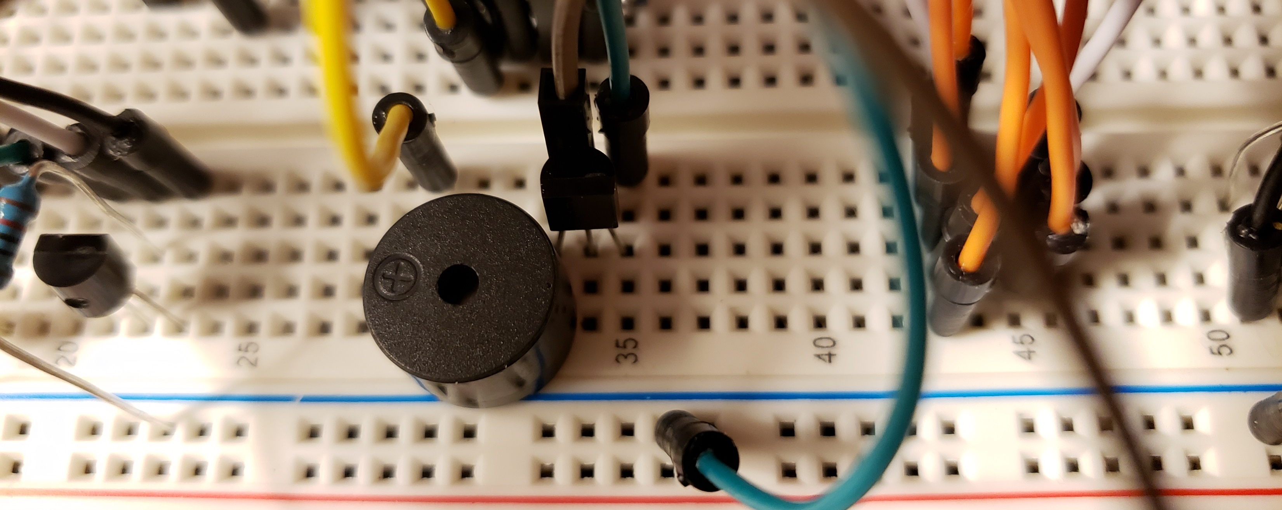
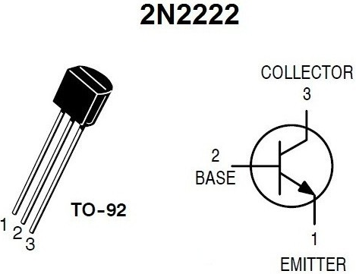
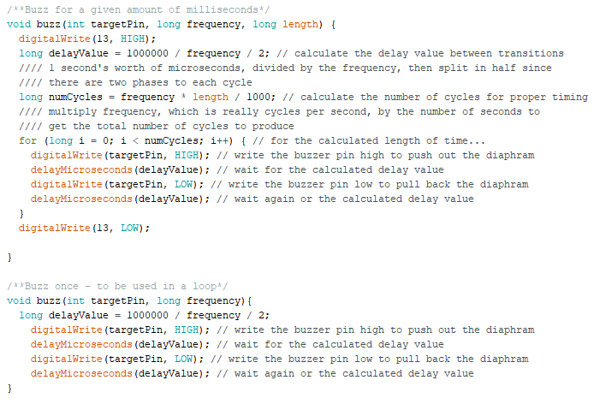
How?
Sound?
Using the provided buzzer in the kit
Problem: Its not loud enough!
Solution: Increased power to 5 volts
Used NPN Transistor in kit as a switch to provide voltage from 5v pin on Arduino
Used a library which provided a frequency for every note from B0-D#8
Used a modified digitalWrite from pin 9 to buzzer
Created a sort of PWM signal with shown methods
Regular PWM was not sounding great

Slide 14
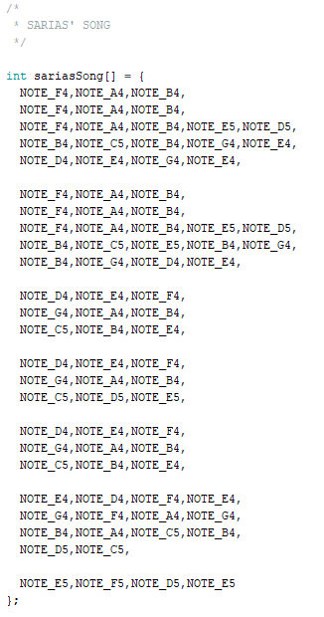
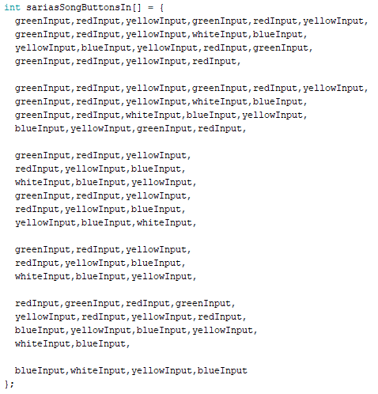
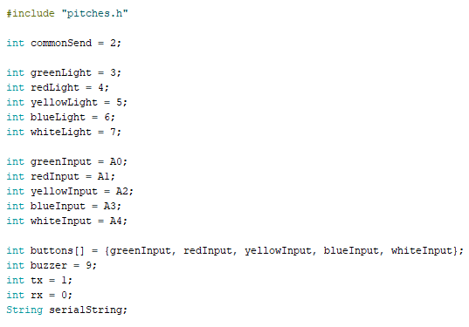
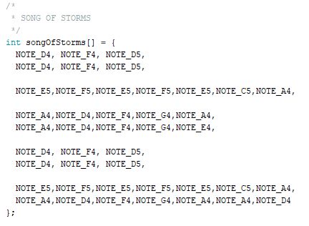
Code: (Music)

Slide 15
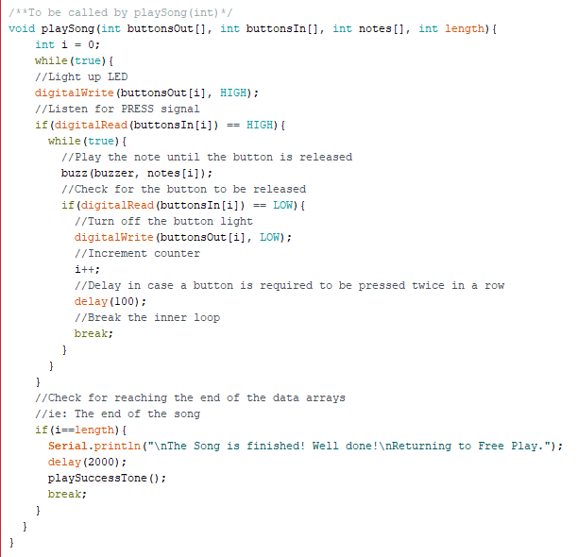
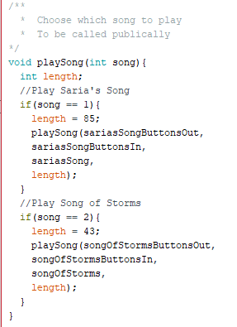
Code: (Music)

Slide 16
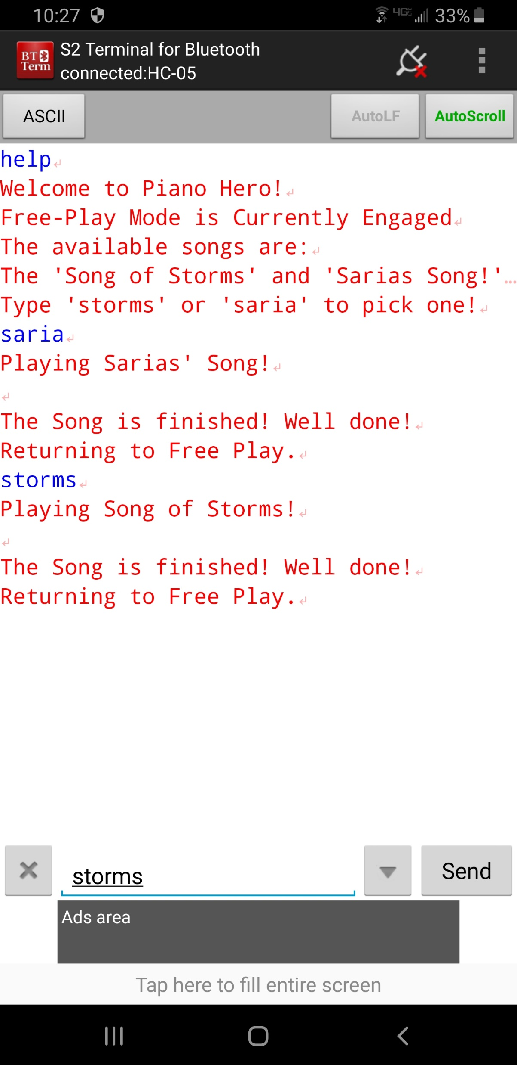
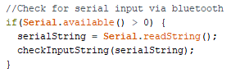
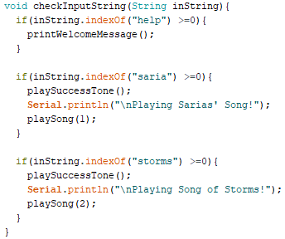
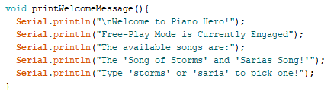
Code: (Bluetooth)

Slide 17
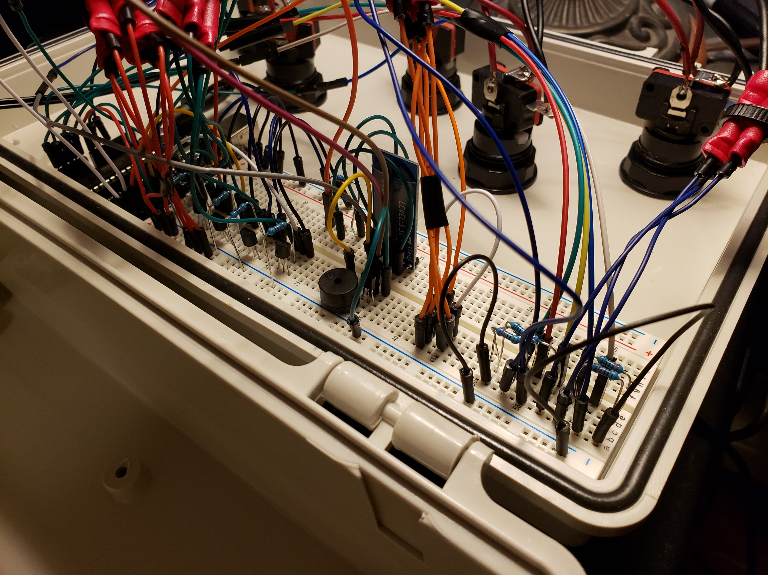

Slide 18
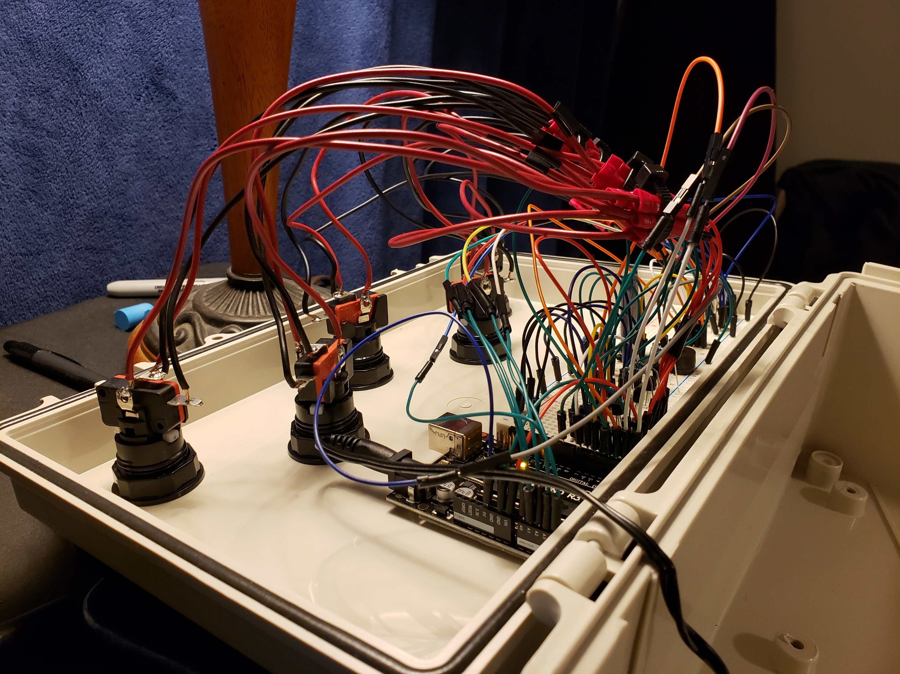

Slide 19
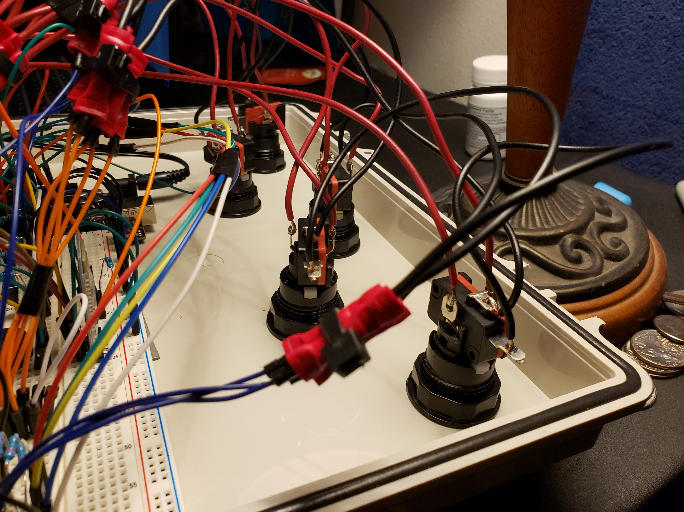

Slide 20
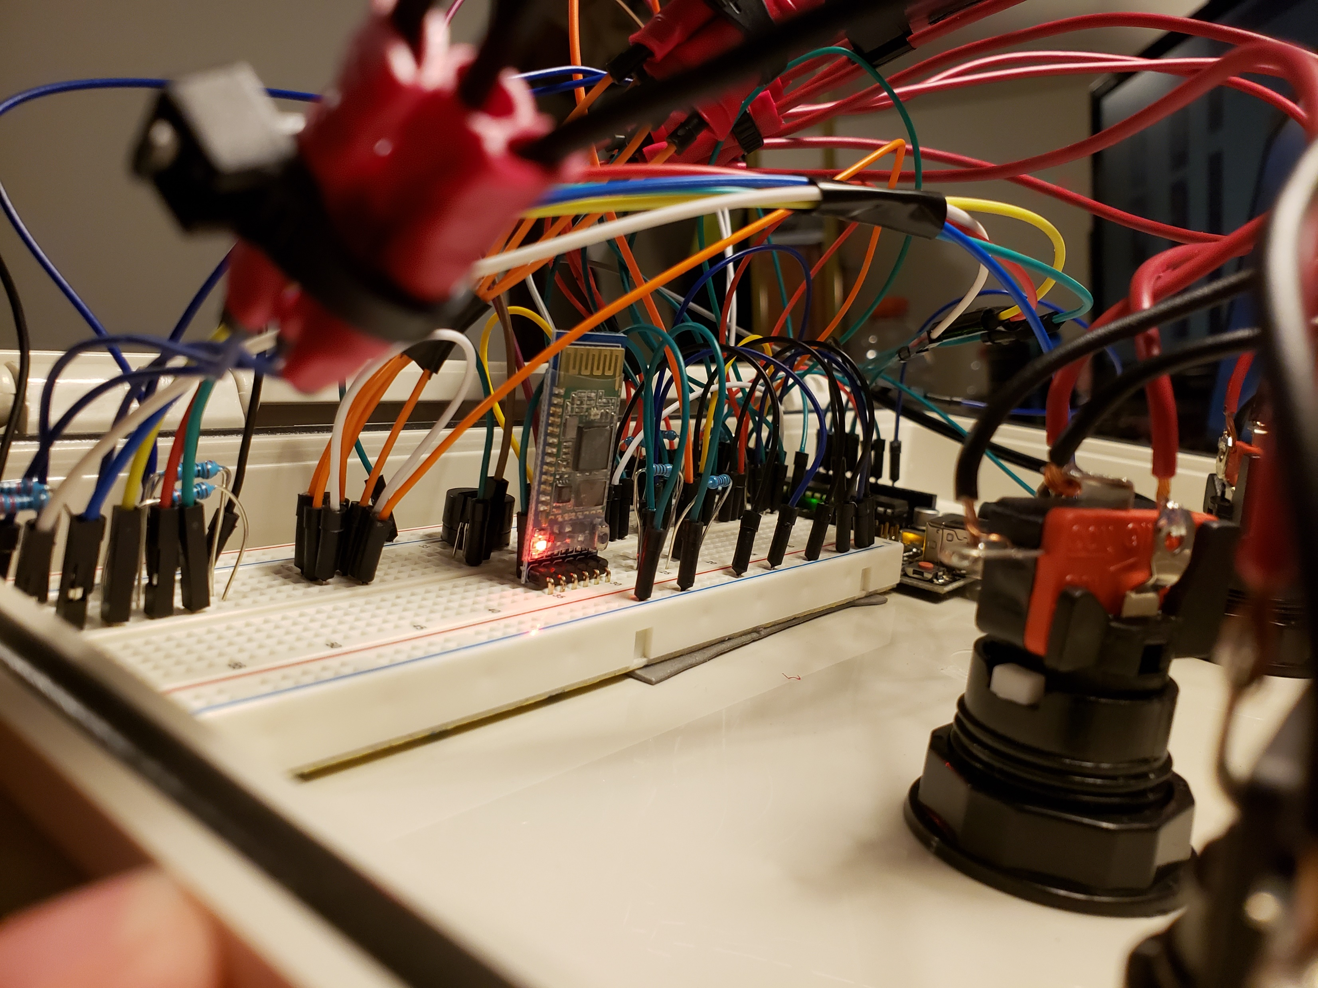

Slide 21
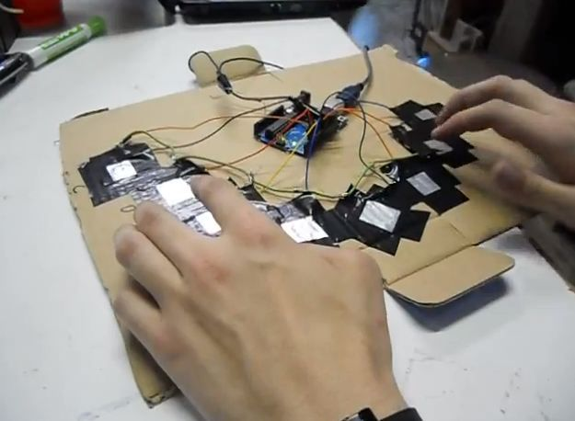
Compared to a Similar Product
https://www.instructables.com/id/Capacitive-Touch-Arduino-Keyboard-Piano/
My inspiration for this project
An instructable article which detailed a Capacitive-Touch Arduino Keyboard Piano
Uses a 5v signal sent to all aluminum foil keys
Senses when a finger presses the keys and plays a note on the buzzer
I borrowed the idea of a “common send” voltage to all buttons
Initially I wanted to AnalogWrite different frequencies to each button and read all buttons on a single pin
This approach proved much more simple and I still have pins to spare
I also borrowed the library of different note frequencies

Slide 22
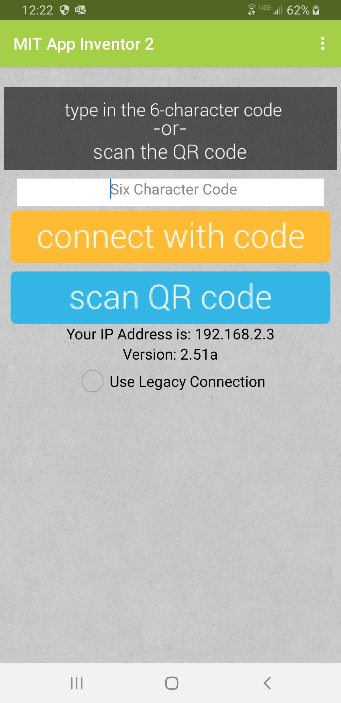
Future Work:
A full Android App
Easy, clickable buttons quick send Bluetooth commands
This will make the project more child friendly
I researched a solution provided by MIT called App Inventor
Allows anyone to build apps quickly
Used in Bluetooth to Android examples I’ve seen
Create an app via the web and produce a code to pair the app to your phone
I will soon be developing Kotlin in IntelliJ
The Android SDK was recently switched from Eclipse IDE to IntelliJ and Kotlin development for Android is possible
In the future I can build a full-fledged application and use it to store and communicate data for several songs

Slide 23
Demonstration Video:
https://www.youtube.com/watch?v=F7LMoaXS20Q&feature=youtu.be

